Slide 1
CSE 320: Code Optimization
Chapter 5
Professor Dan Benz

Slide 2
Good Code is:
Correct
  No bugs
  Correctly implements its features
Readable & Flexible
  If the code can’t be maintained, it will be replaced
Fast
  Run-time of a program matters
Lean
  Excess Memory usage is bad

Slide 3
Not all optimization is created equal:
Big-O (asymptotic complexity) is easy to estimate with significant effects
  You should be considering your algorithms and data structures when writing any program
The optimization we discuss in this class is different:
  “Premature optimization is the root of all evil” - Donald E. Knuth
  These techniques may decrease code portability and readability
  They may introduce bugs
  They are difficult (for potentially little benefit)
What should you do?
  1) Enable compiler optimization (lots of benefit, no real drawback)
  2) Run/Profile your code to determine if its performance is sufficient
  3) Rewrite the parts that need it (first algorithms & data structures, this stuff as a last resort)

Slide 4
Monitoring:
time a.out
  Runs your program with 3 outputs:
    Real: how much real-world time passed
    User: how much time your program spent running (not counting OS overhead)
    System: how much time the OS spent running your program
If wall time >> cpu time then it might be an I/O problem
  Use top or iotop (or Performance Monitor in Windows) to monitor performance
  Don’t optimize something that isn’t a bottleneck!

Slide 5
Profiling:
A profiler is a tool that can help you understand your program performance
  Execution Profile:
    How much time spent in each function
    Stack Trace to identify “hot spots”
  Heap Allocation Profile:
    Number of times each site is executed
    List of all sites (to identify heavily used ones)
    Keep track of live objects and total memory usage
How does it work:
  Direct Timing: Add code to monitor behavior (accurate but slows down code)
  Sampling: OS periodically checks in on your code (less accurate, less effect on speed)

Slide 6
Profiler Example:
gprof (GNU Profiler): https://sourceware.org/binutils/docs/gprof/
  gcc -pg main.c //To compile your program with the profiler
  Run program normally (generates gmon.out)
  Use gprof to produce a report
Program: words
  Reads input stream, parses into words, creates a histogram, lists most frequent words
  Words.c (main); wordtab.c (histogram generator); word.c (word object)
  Wordtab.c is likely to be the bottleneck so we isolated those functions for profiling

Slide 7
Words Interfaces:
// word
typedef struct word WORD;
WORD *word_new(char *text);
void word_free(WORD *wp);
int word_get_count(WORD *wp);
int word_update_count(WORD *wp, int incr);
char *word_get_text(WORD *wp);
int word_compare_text(const void *awpp1, const void *awpp2);
int word_compare_count(const void *awpp1, const void *awpp2);
// wordtab
void wordtab_init(void);
void wordtab_tally(char *text);
int wordtab_sort(WORD ***words);

Slide 8
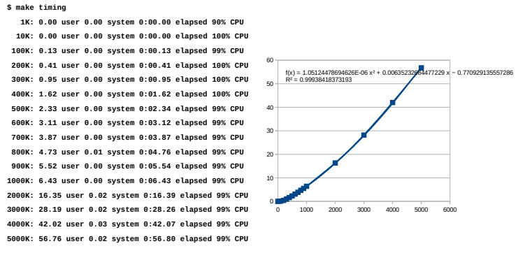
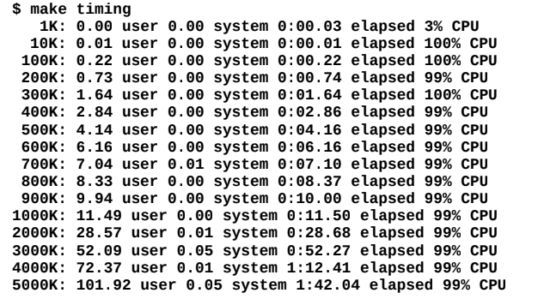
Measurements:
With -pg, timings are 80% slower

Slide 9
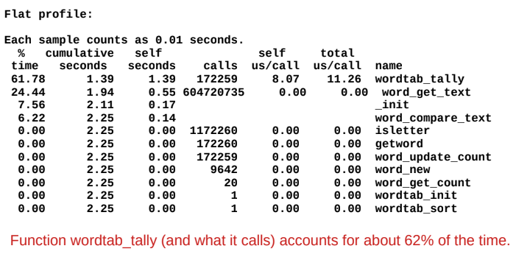
Flat Profile:
bin/words < rsrc/restfile.1000k > /dev/null
gprof bin/words

Slide 10
What is taking wordtab_tally so long?
It does a linear search when counting instances of a word
  Let’s replace with Binary search and see what happens

Slide 11
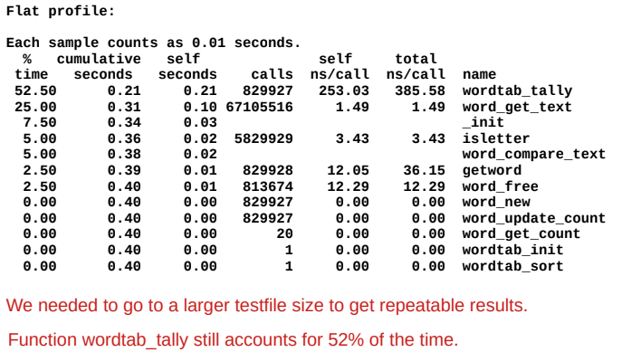
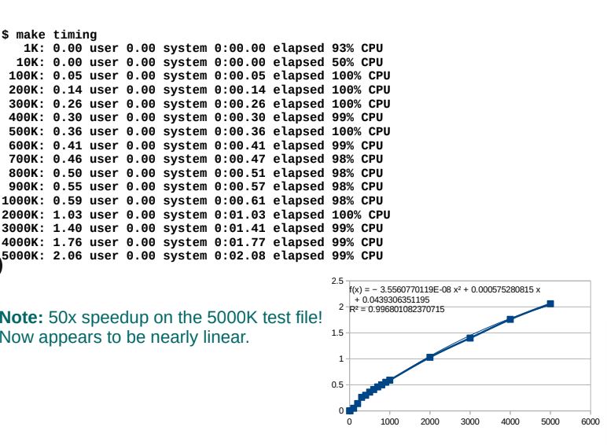
After fixing search:

Slide 12
How to optimize with a profiler:
Focus on the functions consuming the most time
  Could be a slow function
  Could be a frequently used function
Make sure to compare the results whenever you make a change
  Sometimes you make things worse!
  Version control can help quite a bit with this!

Slide 13
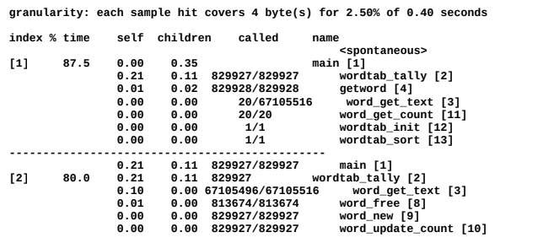
Profiler Call Graphs:
A call graph helps you understand the function calling behavior of the program
Each section focuses on one function and its chain of subfunctions
  Cycles get their own section
  A function can have multiple sections if it gets called from different contexts
Functions to dig into:
  wordtab_tally (829927 calls for 80% of runtime)
  Word_get_text (67105516 calls for 25% of runtime)

Slide 14
Ideas:
No clear way to reduce calls to wordtab_tally (once per word)
Still a linear scan on each new word (marginal impact)
Large number of calls to word_get_text (part of modularity)
  Maybe we can inline it?
  3 ways to inline a function:
    1) Delete the function and expose the field directly (terrible for maintainability)
    2) Make it a Macro instead of a function (messy, but still maintainable)
    3) Use the inline keyword (Yeah, let’s go with this)

Slide 15
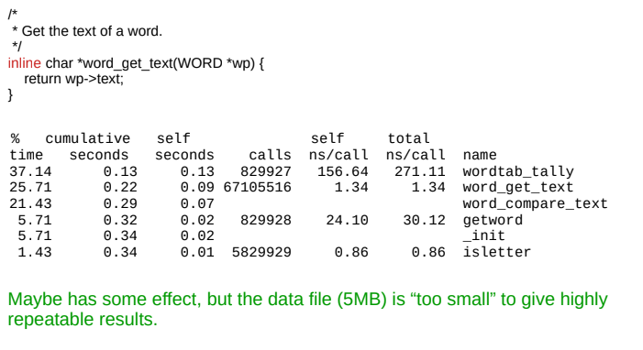
Inline:

Slide 16
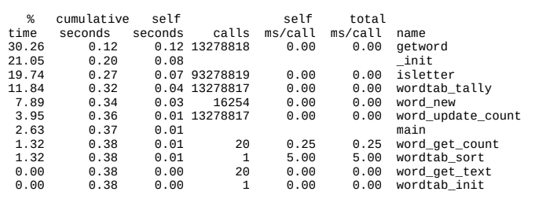
More ideas:
If we want to avoid ALL linear operations we can store the words in a hash
Could try to optimize the “isletter” function (only 20% to be gained!)

Slide 17
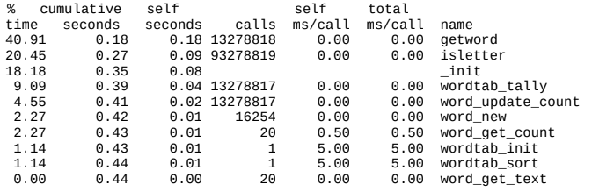
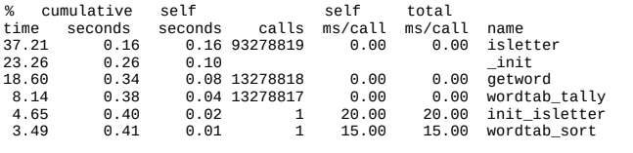
Isletter optimizations:
Try inlining:
Try Lookup Table:

Slide 18
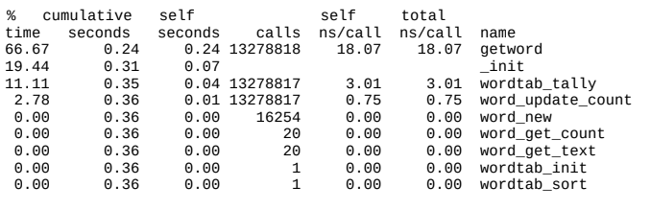
Compiler Optimizations:
-O2:

Slide 19
Summary:
Turn on Compiler Optimizations
  No downside to readability, gives you most of the improvements
Declare functions as “inline”
  Compiler can do this too, but it benefits some functions more than others
Replace functions with macros
  Similar to inlining but requires more careful programming
Substitute algorithms and data structures
  Great potential benefits, good motivation for writing modular/clean code
Break module encapsulation to expose internals
  AVOID THIS!!! Minor performance boost at the cost of maintainability!

Slide 20
Types of Optimizations:
Code Motion
Dead Code Elimination
Reduction in Strength
Sharing Common Subexpressions
(removing) Memory Aliasing
Loop Unrolling
Function Inlining / Reducing Procedure Calls
The compiler will do most of these but you might need to help it and you should learn what they are

Slide 21
Performance Realities
There’s more to performance than asymptotic complexity
  Constant factors matter too!
    Easily see 10:1 performance range depending on how code is written
    Must optimize at multiple levels:
      algorithm, data representations, procedures, and loops
  Must understand system to optimize performance
    How programs are compiled and executed
    How modern processors + memory systems operate
    How to measure program performance and identify bottlenecks
    How to improve performance without destroying code modularity and generality

Slide 22
Optimizing Compilers
Provide efficient mapping of program to machine
  register allocation
  code selection and ordering (scheduling)
  dead code elimination
  eliminating minor inefficiencies
Don’t (usually) improve asymptotic efficiency
  up to programmer to select best overall algorithm
  big-O savings are (often) more important than constant factors
    but constant factors also matter
Have difficulty overcoming “optimization blockers”
  potential memory aliasing
  potential procedure side-effects

Slide 23
Limitations of Optimizing Compilers
Operate under fundamental constraint
  Must not cause any change in program behavior
    Except, possibly when program making use of nonstandard language features
  Often prevents it from making optimizations that would only affect behavior under pathological conditions.
Behavior that may be obvious to the programmer can be obfuscated by languages and coding styles
  e.g., Data ranges may be more limited than variable types suggest
Most analysis is performed only within procedures
  Whole-program analysis is too expensive in most cases
  Newer versions of GCC do interprocedural analysis within individual files
    But, not between code in different files
Most analysis is based only on static information
  Compiler has difficulty anticipating run-time inputs
When in doubt, the compiler must be conservative

Slide 24
Generally Useful Optimizations
Optimizations that you or the compiler should do regardless of processor / compiler
Code Motion
  Reduce frequency with which computation performed
    If it will always produce same result
    Especially moving code out of loop
void set_row(double *a, double *b,
long i, long n)
{
long j;
for (j = 0; j < n; j++)
a[n*i+j] = b[j];
}
long j;
int ni = n*i;
for (j = 0; j < n; j++)
a[ni+j] = b[j];

Slide 25
Compiler-Generated Code Motion (-O1)
void set_row(double *a, double *b,
long i, long n)
{
long j;
for (j = 0; j < n; j++)
a[n*i+j] = b[j];
}
long j;
long ni = n*i;
double *rowp = a+ni;
for (j = 0; j < n; j++)
*rowp++ = b[j];

Slide 26
Reduction in Strength
  Replace costly operation with simpler one
  Shift, add instead of multiply or divide
    16*x --> x << 4
    Utility machine dependent
    Depends on cost of multiply or divide instruction
      On Intel Nehalem, integer multiply requires 3 CPU cycles
  Recognize sequence of products
int ni = 0;
for (i = 0; i < n; i++) {
for (j = 0; j < n; j++)
a[ni + j] = b[j];
ni += n;
}
for (i = 0; i < n; i++) {
int ni = n*i;
for (j = 0; j < n; j++)
a[ni + j] = b[j];
}

Slide 27
Share Common Subexpressions
  Reuse portions of expressions
  GCC will do this with –O1
/* Sum neighbors of i,j */
up = val[(i-1)*n + j ];
down = val[(i+1)*n + j ];
left = val[i*n + j-1];
right = val[i*n + j+1];
sum = up + down + left + right;
long inj = i*n + j;
up = val[inj - n];
down = val[inj + n];
left = val[inj - 1];
right = val[inj + 1];
sum = up + down + left + right;
3 multiplications: i*n, (i–1)*n, (i+1)*n
1 multiplication: i*n

Slide 28
Optimization Blocker #1: Procedure Calls
Procedure to Convert String to Lower Case
  What is wrong with this code?
void lower(char *s)
{
size_t i;
for (i = 0; i < strlen(s); i++)
if (s[i] >= 'A' && s[i] <= 'Z')
s[i] -= ('A' - 'a');
}

Slide 29
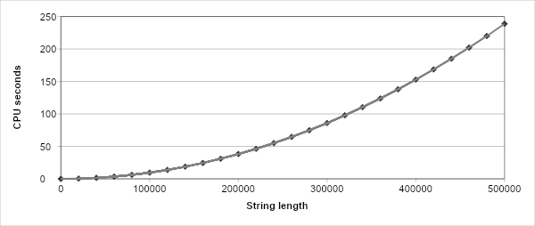
Lower Case Conversion Performance
  Time quadruples when double string length
  Quadratic performance
lower1

Slide 30
Convert Loop To Goto Form
  strlen executed every iteration
void lower(char *s)
{
size_t i = 0;
if (i >= strlen(s)) goto done;
loop:
if (s[i] >= 'A' && s[i] <= 'Z')
s[i] -= ('A' - 'a');
i++;
if (i < strlen(s)) goto loop;
done:
}

Slide 31
Calling Strlen
Strlen performance
  Only way to determine length of string is to scan its entire length, looking for null character.
Overall performance, string of length N
  N calls to strlen
  Require times N, N-1, N-2, …, 1
  Overall O(N²) performance
/* My version of strlen */
size_t strlen(const char *s)
{
size_t length = 0;
while (*s != '\0')
{s++; length++;}
return length;
}

Slide 32
Improving Performance
  Move call to strlen outside of loop
  Since result does not change from one iteration to another
  Form of code motion
void lower(char *s)
{
size_t i;
size_t len = strlen(s);
for (i = 0; i < len; i++)
if (s[i] >= 'A' && s[i] <= 'Z')
s[i] -= ('A' - 'a');
}

Slide 33
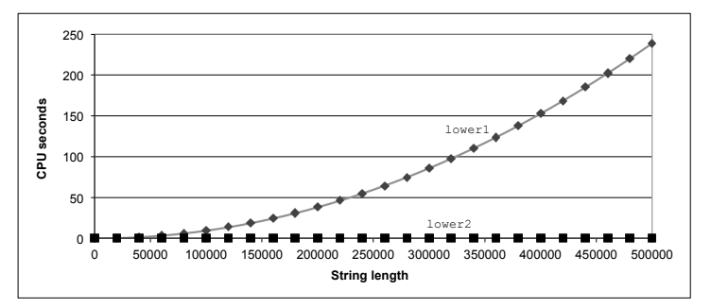
Lower Case Conversion Performance (Improved)
  Time doubles when double string length
  Linear performance of lower2

Slide 34
Optimization Blocker: Procedure Calls
Why couldn’t compiler move strlen out of inner loop?
  Procedure may have side effects
    Alters global state each time called
  Function may not return same value for given arguments
    Depends on other parts of global state
    Procedure lower could interact with strlen
Warning:
  Compiler treats procedure call as a black box
  Weak optimizations near them
Remedies:
  Use of inline functions
    GCC does this with –O1
      Within single file
  Do your own code motion
size_t lencnt = 0;
size_t strlen(const char *s)
{
size_t length = 0;
while (*s != '\0')
{ s++; length++; }
lencnt += length;
return length;
}

Slide 35
Memory Matters
  Code updates b[i] on every iteration
  Why couldn’t compiler optimize this away?
/* Sum rows is of n X n matrix a
and store in vector b */
void sum_rows1(double *a, double *b, long n) {
long i, j;
for (i = 0; i < n; i++) {
b[i] = 0;
for (j = 0; j < n; j++)
b[i] += a[i*n + j];
}
}
# sum_rows1 inner loop
.L4:
movsd (%rsi,%rax,8), %xmm0 # FP load
addsd (%rdi), %xmm0 # FP add
movsd %xmm0, (%rsi,%rax,8) # FP store
addq $8, %rdi
cmpq %rcx, %rdi
jne .L4

Slide 36
Memory Aliasing
double A[9] =
{ 0, 1, 2,
4, 8, 16},
32, 64, 128};
double B[3] = A+3;
sum_rows1(A, B, 3);
  Code updates b[i] on every iteration
  Must consider possibility that these updates will affect program behavior
/* Sum rows is of n X n matrix a
and store in vector b */
void sum_rows1(double *a, double *b, long n) {
long i, j;
for (i = 0; i < n; i++) {
b[i] = 0;
for(j = 0; j < n; j++) b[i] += a[i*n + j];
}
}
Value of B:
init: [4, 8, 16]
i = 0: [3, 8, 16]
i = 1: [3, 22, 16]
i = 2: [3, 22, 224]

Slide 37
Removing Aliasing
/* Sum rows is of n X n matrix a
and store in vector b */
void sum_rows2(double *a, double *b, long n) {
long i, j;
for (i = 0; i < n; i++) {
double val = 0;
for (j = 0; j < n; j++)
val += a[i*n + j];
b[i] = val;
}
}
  No need to store intermediate results
# sum_rows2 inner loop
.L10:
addsd (%rdi), %xmm0 # FP load + add
addq $8, %rdi
cmpq %rax, %rdi
jne .L10

Slide 38
Optimization Blocker: Memory Aliasing
Aliasing
  Two different memory references specify single location
  Easy to have happen in C
    Since allowed to do address arithmetic
    Direct access to storage structures
  Get in habit of introducing local variables
    Accumulating within loops
    Your way of telling compiler not to check for aliasing

Slide 39
Exploiting Instruction-Level Parallelism
Need general understanding of modern processor design
  Hardware can execute multiple instructions in parallel
Performance limited by data dependencies
Simple transformations can yield dramatic performance improvement
  Compilers often cannot make these transformations
  Lack of associativity and distributivity in floating-point arithmetic

Slide 40

Benchmark Example: Data Type for Vectors
/* data structure for vectors */
typedef struct{
size_t len;
data_t *data;
} vec;
/* retrieve vector element
and store at val */
int get_vec_element
(*vec v, size_t idx, data_t *val)
{
if (idx >= v->len)
return 0;
*val = v->data[idx];
return 1;
}
Data Types
  Use different declarations for data_t
  int
  long
  float
  double

Slide 41
Benchmark Computation
void combine1(vec_ptr v, data_t *dest)
{
long int i; *dest = IDENT;
for (i = 0; i < vec_length(v); i++) {
data_t val;
get_vec_element(v, i, &val);
*dest = *dest OP val; }
}
Compute sum or product of vector elements
Data Types
  Use different declarations for data_t
  int
  long
  float
  double
Operations
  Use different definitions of OP and IDENT
  + / 0
  * / 1

Slide 42
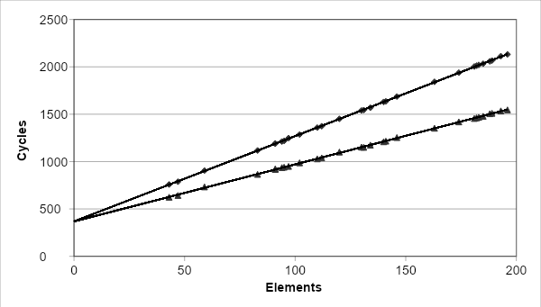
Cycles Per Element (CPE)
Convenient way to express performance of program that operates on vectors or lists
Length = n
In our case: CPE = cycles per OP
T = CPE*n + Overhead
  CPE is slope of line
psum1
Slope = 9.0
psum2
Slope = 6.0

Slide 43
Benchmark Performance
void combine1(vec_ptr v, data_t *dest)
{
long int i; *dest = IDENT;
for (i = 0; i < vec_length(v); i++)
{ data_t val;
get_vec_element(v, i, &val);
*dest = *dest OP val; }
}
Compute sum or product of vector elements
Operation | Integer Add | Integer Mult | Double FP Add | Double FP Mult
Combine1 unoptimized | 22.68 | 20.02 | 19.98 | 20.18
Combine1 –O1 | 10.12 | 10.12 | 10.17 | 11.14

Slide 44
Basic Optimizations
void combine4(vec_ptr v, data_t *dest)
{
long i;
long length = vec_length(v);
data_t *d = get_vec_start(v);
data_t t = IDENT;
for (i = 0; i < length; i++)
t = t OP d[i];
*dest = t;
}
Move vec_length out of loop
Avoid bounds check on each cycle
Accumulate in temporary

Slide 45
Effect of Basic Optimizations
Eliminates sources of overhead in loop
void combine4(vec_ptr v, data_t *dest)
{ long i;
long length = vec_length(v);
data_t *d = get_vec_start(v);
data_t t = IDENT;
for (i = 0; i < length; i++)
t = t OP d[i];
*dest = t;}
Operation | Integer Add | Integer Mult | Double FP Add | Double FP Mult
Combine1 –O1 | 10.12 | 10.12 | 10.17 | 11.14
Combine4 | 1.27 | 3.01 | 3.01 | 5.01

Slide 46
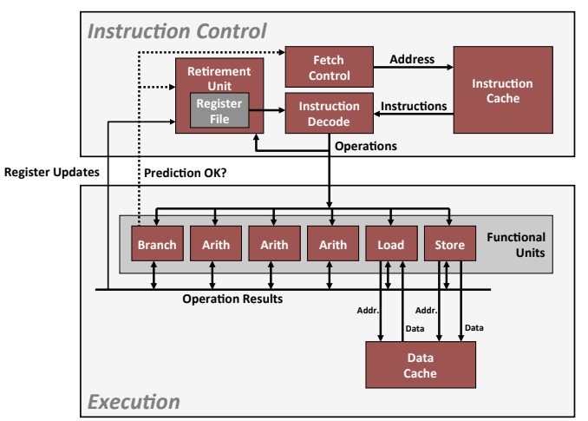
Modern CPU Design

Slide 47
Superscalar Processor
Definition: A superscalar processor can issue and execute multiple instructions in one cycle. The instructions are retrieved from a sequential instruction stream and are usually scheduled dynamically.
Benefit: without programming effort, superscalar processor can take advantage of the instruction level parallelism that most programs have
Most modern CPUs are superscalar.
Intel: since Pentium (1993)

Slide 48
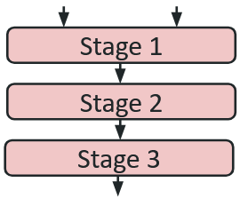
Pipelined Functional Units
long mult_eg(long a, long b, long c) {
long p1 = a*b;
long p2 = a*c;
long p3 = p1 * p2;
return p3;
}
Clock: | 1 | 2 | 3 | 4 | 5 | 6 | 7
Stage 1 | a*b | a*c | NOP | NOP | p1*p2 | NOP | NOP
Stage 2 | NOP | a*b | a*c | NOP | NOP | p1*p2 | NOP
Stage 3 | NOP | NOP | a*b | a*c | NOP | NOP | p1*p2
  Divide computation into stages
  Pass partial computations from stage to stage
  Stage i can start on new computation once values passed to i+1
  E.g., complete 3 multiplications in 7 cycles, even though each requires 3 cycles

Slide 49
Haswell CPU
8 Total Functional Units
Multiple instructions can execute in parallel
  2 load, with address computation
  1 store, with address computation
  4 integer
  2 FP multiply
  1 FP add
  1 FP divide
Some instructions take > 1 cycle, but can be pipelined
Instruction Latency Cycles/Issue
Load / Store 4 1
Integer Multiply 3 1
Integer/Long Divide 3-30 3-30
Single/Double FP Multiply 5 1
Single/Double FP Add 3 1
Single/Double FP Divide 3-15 3-15

Slide 50
x86-64 Compilation of Combine4
Inner Loop (Case: Integer Multiply)
.L519: # Loop:
imull (%rax,%rdx,4), %ecx # t = t * d[i]
addq $1, %rdx # i++
cmpq %rdx, %rbp # Compare length:i
jg .L519 # If >, goto Loop
Operation | Integer Add | Integer Mult | Double FP Add | Double FP Mult
Combine4 | 1.27 | 3.01 | 3.01 | 5.01
Latency Bound | 1.00 | 3.00 | 3.00 | 5.00

Slide 51
Combine4 = Serial Computation (OP = *)
1
d₀
Computation (length=8)
  ((((((((1 * d[0]) * d[1]) * d[2]) * d[3]) * d[4]) * d[5]) * d[6]) * d[7])
Sequential dependence
  Performance: determined by latency of OP
*
d₁
*
d₂
*
d₃
*
d₄
*
d₅
*
d₆
*
d₇
*

Slide 52
Loop Unrolling (2x1)
void unroll2a_combine(vec_ptr v,
data_t *dest)
{
long length = vec_length(v);
long limit = length-1;
data_t *d = get_vec_start(v);
data_t x = IDENT;
long i;
/* Combine 2 elements at a time */
for (i = 0; i < limit; i+=2) {
x = (x OP d[i]) OP d[i+1];
}
/* Finish any remaining elements */
for (; i < length; i++) {
x = x OP d[i];
}
*dest = x;
}
Perform 2x more useful work per iteration

Slide 53
Effect of Loop Unrolling
Operation | Integer Add | Integer Mult | Double FP Add | Double FP Mult
Combine4 | 1.27 | 3.01 | 3.01 | 5.01
Unroll 2x1 | 1.01 | 3.01 | 3.01 | 5.01
Latency Bound | 1.00 | 3.00 | 3.00 | 5.00
Helps integer add
  Achieves latency bound
Others don’t improve. Why?
  Still sequential dependency
x = (x OP d[i]) OP d[i+1];

Slide 54
Loop Unrolling with Reassociation (2x1a)
void unroll2aa_combine(vec_ptr v, data_t *dest)
{
long length = vec_length(v);
long limit = length-1;
data_t *d = get_vec_start(v);
data_t x = IDENT;
long i;
/* Combine 2 elements at a time */
for (i = 0; i < limit; i+=2) {
x = x OP (d[i] OP d[i+1]);
}
/* Finish any remaining elements */
for (; i < length; i++) {x = x OP d[i]; }
*dest = x;
}
Compare to before
x = (x OP d[i]) OP d[i+1];
Can this change the result of the computation?
Yes, for FP. Why?

Slide 55
Effect of Reassociation
Operation | Integer Add | Integer Mult | Double FP Add | Double FP Mult
Combine4 | 1.27 | 3.01 | 3.01 | 5.01
Unroll 2x1 | 1.01 | 3.01 | 3.01 | 5.01
Unroll 2x1a | 1.01 | 1.51 | 1.51 | 2.51
Latency Bound | 1.00 | 3.00 | 3.00 | 5.00
Throughput Bound | 0.50 | 1.00 | 1.00 | 0.50
Nearly 2x speedup for Int *, FP +, FP *
  Reason: Breaks sequential dependency
2 func. units for FP *
2 func. units for load
x = x OP (d[i] OP d[i+1]);
4 func. units for int +
2 func. units for load

Slide 56
Reassociated Computation
x = x OP (d[i] OP d[i+1]);
What changed:
  Ops in the next iteration can be started early (no dependency)
Overall Performance
  N elements, D cycles latency/op
  (N/2+1)*D cycles: CPE = D/2
d₀
d₁
*
d₂
d₃
1
*
d₄
d₅
*
*
d₆
d₇
*
*
*
*

Slide 57
Loop Unrolling with Separate Accumulators (2x2)
void unroll2a_combine(vec_ptr v, data_t *dest)
{
long length = vec_length(v);
long limit = length-1;
data_t *d = get_vec_start(v);
data_t x0 = IDENT;
data_t x1 = IDENT;
long i;
/* Combine 2 elements at a time */
for (i = 0; i < limit; i+=2) {
x0 = x0 OP d[i];
x1 = x1 OP d[i+1];
}
/* Finish any remaining elements */
for (; i < length; i++) {
x0 = x0 OP d[i];
}
*dest = x0 OP x1;
}
Different form of reassociation

Slide 58
Effect of Separate Accumulators
Operation | Integer Add | Integer Mult | Double FP Add | Double FP Mult
Combine4 | 1.27 | 3.01 | 3.01 | 5.01
Unroll 2x1 | 1.01 | 3.01 | 3.01 | 5.01
Unroll 2x1a | 1.01 | 1.51 | 1.51 | 2.51
Unroll 2x2 | 0.81 | 1.51 | 1.51 | 2.51
Latency Bound | 1.00 | 3.00 | 3.00 | 5.00
Throughput Bound | 0.50 | 1.00 | 1.00 | 0.50
x0 = x0 OP d[i];
x1 = x1 OP d[i+1];
Int + makes use of two load units
2x speedup (over unroll2) for Int *, FP +, FP *

Slide 59
Separate Accumulators
What changed:
  Two independent “streams” of operations
Overall Performance
  N elements, D cycles latency/op
  Should be (N/2+1)*D cycles: CPE = D/2
  CPE matches prediction!
x0 = x0 OP d[i];
x1 = x1 OP d[i+1];
1
d₀
1
d₁
*
d₂
*
d₃
*
d₄
*
d₅
*
d₆
*
d₇
*
*
*
What Now?

Slide 60
Unrolling & Accumulating
Idea
  Can unroll to any degree L
  Can accumulate K results in parallel
  L must be multiple of K
Limitations
  Diminishing returns
    Cannot go beyond throughput limitations of execution units
  Large overhead for short lengths
    Finish off iterations sequentially

Slide 61
Unrolling & Accumulating: Double *
Case
  Intel Haswell
  Double FP Multiplication
  Latency bound: 5.00. Throughput bound: 0.50
K rows; L cols | 1 | 2 | 3 | 4 | 6 | 8 | 10 | 12
1 | 5.01 | 5.01 | 5.01 | 5.01 | 5.01 | 5.01 | 5.01 | -
2 | - | 2.51 | - | 2.51 | - | 2.51 | - | -
3 | - | - | 1.67 | - | - | - | - | -
4 | - | - | - | 1.25 | - | 1.26 | - | -
6 | - | - | - | - | 0.84 | - | - | 0.88
8 | - | - | - | - | - | 0.63 | - | -
10 | - | - | - | - | - | - | 0.51 | -
12 | - | - | - | - | - | - | - | 0.52
Accumulators

Slide 62
Unrolling & Accumulating: Int +
Case
  Intel Haswell
  Integer addition
  Latency bound: 1.00. Throughput bound: 0.50
K rows; L cols | 1 | 2 | 3 | 4 | 6 | 8 | 10 | 12
1 | 1.27 | 1.01 | 1.01 | 1.01 | 1.01 | 1.01 | 1.01 | -
2 | - | 0.81 | - | 0.69 | - | 0.54 | - | -
3 | - | - | 0.74 | - | - | - | - | -
4 | - | - | - | 0.69 | - | 1.24 | - | -
6 | - | - | - | - | 0.56 | - | - | 0.56
8 | - | - | - | - | - | 0.54 | - | -
10 | - | - | - | - | - | - | 0.54 | -
12 | - | - | - | - | - | - | - | 0.56
Accumulators

Slide 63
Achievable Performance
Operation | Integer Add | Integer Mult | Double FP Add | Double FP Mult
Best | 0.54 | 1.01 | 1.01 | 0.52
Latency Bound | 1.00 | 3.00 | 3.00 | 5.00
Throughput Bound | 0.50 | 1.00 | 1.00 | 0.50
Limited only by throughput of functional units
Up to 42X improvement over original, unoptimized code

Slide 64
What About Branches?
Challenge
  Instruction Control Unit must work well ahead of Execution Unit to generate enough operations to keep EU busy
404663: mov $0x0,%eax
404668: cmp (%rdi),%rsi
40466b: jge 404685
40466d: mov 0x8(%rdi),%rax
. . .
404685: repz retq
Executing
How to continue?
When encounters conditional branch, cannot determine where to fetch next

Slide 65
Modern CPU Design (repeated)

Slide 66
Branch Outcomes
When encounter conditional branch, cannot determine where to continue fetching
  Branch Taken: Transfer control to branch target
  Branch Not-Taken: Continue with next instruction in sequence
Cannot resolve until outcome determined by branch/integer unit
Idea
  Guess which way branch will go
  Begin executing instructions at predicted position
    But don’t actually modify register or memory data

Slide 67
Branch Prediction Through Loop
401029: vmulsd (%rdx),%xmm0,%xmm0
40102d: add $0x8,%rdx
401031: cmp %rax,%rdx
401034: jne 401029
Assume
vector length = 100
i = 98
Predict Taken (OK)
401029: vmulsd (%rdx),%xmm0,%xmm0
40102d: add $0x8,%rdx
401031: cmp %rax,%rdx
401034: jne 401029
i = 99
Predict Taken
(Oops)
401029: vmulsd (%rdx),%xmm0,%xmm0
40102d: add $0x8,%rdx
401031: cmp %rax,%rdx
401034: jne 401029
Read invalid location
Executed
i = 100
401029: vmulsd (%rdx),%xmm0,%xmm0
40102d: add $0x8,%rdx
401031: cmp %rax,%rdx
401034: jne 401029
Fetched
i = 101

Slide 68
Branch Misprediction Invalidation
401029: vmulsd (%rdx),%xmm0,%xmm0
40102d: add $0x8,%rdx
401031: cmp %rax,%rdx
401034: jne 401029
Assume
vector length = 100
i = 98
Predict Taken (OK)
401029: vmulsd (%rdx),%xmm0,%xmm0
40102d: add $0x8,%rdx
401031: cmp %rax,%rdx
401034: jne 401029
i = 99
Predict Taken (Oops)
401029: vmulsd (%rdx),%xmm0,%xmm0
40102d: add $0x8,%rdx
401031: cmp %rax,%rdx
401034: jne 401029
i = 100
Invalidate
401029: vmulsd (%rdx),%xmm0,%xmm0
40102d: add $0x8,%rdx
401031: cmp %rax,%rdx
401034: jne 401029
i = 101

Slide 69
Branch Misprediction Recovery
401029: vmulsd (%rdx),%xmm0,%xmm0
40102d: add $0x8,%rdx
401031: cmp %rax,%rdx
401034: jne 401029
401036: jmp 401040
. . .
401040: vmovsd %xmm0,(%r12)
i = 99
Definitely not taken
Reload
Pipeline
Performance Cost
  Multiple clock cycles on modern processor
  Can be a major performance limiter

Slide 70
Getting High Performance
Good compiler and flags
Don’t do anything stupid
  Watch out for hidden algorithmic inefficiencies
  Write compiler-friendly code
    Watch out for optimization blockers:
      procedure calls & memory references
  Look carefully at innermost loops (where most work is done)
Tune code for machine
  Exploit instruction-level parallelism
  Avoid unpredictable branches
  Make code cache friendly (Covered later in course)

